Slide 1
Containing a community crisis: an end of life perspective -
A story with more questions than answers…………

Slide 2
Containing a community crisis: an end of life perspective
Introduction to workshop
Aim to consider:
The difficulties for family and professional carers, caring for a patient like Mr Derek D
The challenges of multiagency community working
The challenges posed by limited resources
The legal constraints that impact on his care
That there are more questions than answers………..
Objectives:
Understand complexity of:
  multiagency working with
  limited resources, and
  the Law governing the management of care in this situation.
Consider individual and collective solutions to the situation described.

Slide 3
Containing a community crisis: an end of life perspective
Introduction to workshop
Workshop leads -
Jodie Grace - Macmillan Paramedic Associate
Britain Baker – ST4 Trainee Psychiatrist
Matt James – Associate Professor, Bioethics & Medical Law
Siân Davies – Associate Specialist in Palliative Medicine
Notes:
Matt - introduction – 5mins

Slide 4
Containing a community crisis: an end of life perspective
The Patient’s History
Mr. Derek D
White British – English as first language
A Senior Civil Servant
Lived with wife in spacious home
Adult son and daughter not usually living at home.
Notes:
SD – total 10minutes

Slide 5
Containing a community crisis: an end of life perspective
The Patient’s History
May 2023 arrived at A&E of local hospital with
Confusion
Inability to fasten buttons
Apparently “cannot seem to understand what is being asked of him anymore”
Seen by private GP who recommended going to A&E
Discharged home with a plan for further investigation –
Derek’s fluctuating capacity to consent was an issue
Scans showed extensive oedema bilaterally in the hemispheric white matter
Uncertain of location of primary cancer – or were these multi-focal brain abscesses?
6th June – Biopsy confirmed the diagnosis of a metastatic (non-small cell) cancer of the lung with brain and adrenal metastases (T4 N1 M1c)
8th June – agreed that Derek was not a candidate for active treatment because of the extent of his disease and poor performance status.

Slide 6
Containing a community crisis: an end of life perspective
The Community Palliative Care Story (1)
9th June – Initial referral to the Community Specialist Palliative Care Team received and accepted
12th June - Initial contact made
  Wife, Diana, feels:
  “he is not ready for Palliative Care yet”.
  She agreed to “discuss with her son and daughter”
19th June – Further referral from GP as “deteriorating rapidly”
“Speech worse”
Reduced inhibitions – eg. Walking around their home naked
Throwing food across the room
Loss of appetite
But – still distinguishing wife and other family members

Slide 7
Containing a community crisis: an end of life perspective
The Community Palliative Care Story (2)
20th June – telephone call from his wife, extremely distressed as:
  “refusing to eat and take his medications for past 2/7”.
  Aggressive towards wife
21st June – telephone call to Diana, and agreed a visit the following day
22nd June – (Dr S and Clinical Nurse Specialist) – the meeting took place in their kitchen, where:
Derek wearing disposable pants only
Speech very difficult, and when agitated and distressed – only able to say “No!, no!, no!…….”
Possibly able to comprehend discussion? – as calmer and vocabulary expanded when discussing a neutral topic eg., Malta….!
Agreed to reintroduce a higher dose of Dexamethasone (12mg daily) and reinstate laxatives.

Slide 8
Containing a community crisis: an end of life perspective
The Community Palliative Care Story (3)
26th June – telephone conversation with Diana as she was “struggling to manage”
  Perhaps improved with steroids.
  Derek had been “amiable” and “amenable” when friends visited over the weekend.
But, still –
  Unkempt
  Aggressive
  Disinhibited, with limited clothing
  Incontinent
Diana hoping that we would admit him to Hospice, but not possible that day.
Discussed options for on-going management:
  Continuing with steroids
Advised Diana to contact London Ambulance Service (LAS) for hospital admission if she felt the situation had become unmanageable.

Slide 9
Containing a community crisis: an end of life perspective
The Community Palliative Care Story (4)
28th June – we received a call from an LAS paramedic requesting our assessment of Derek as he was deteriorating, his behaviour worsening – walking around naked and soiled.
We recommended and agreed for hospital admission to manage symptoms and allow for assessment and management of his challenging behaviour.
A suggestion was made that we might attend to “administer an injection” to enable Derek’s transfer to the Ambulance
Diana felt that Derek “had no capacity” to make such a decision, and could simply be put in the Ambulance.
Sadly, on that particular day, six days after we first met him, we had no available staff to attend and support

Slide 10
Containing a community crisis: an end of life perspective
The London Ambulance Paramedic’s Story (1)
All the information you have heard so far would have yet to be known to us.
Timeline on 28th June:
08:37 – Diana calls NHS111
09:41 – 999 call from 111 (Category 3 – up to 120minute response time)
10:09 Ambulance dispatched
10:15 Ambulance crew arrives at the address

Slide 11
Containing a community crisis: an end of life perspective
The London Ambulance Paramedic’s Story (2)
Actions taken by the Crew –
Initial assessment:
Derek is sitting at the table
History is then provided by Diana
Observations:
blood glucose recorded,
other observations not possible due to behaviour
Capacity – deemed patient lacked
Contacted GP and hospice: Consensus reached by all involved was to convey Derek to the hospital
Assumption by crew: Hospice could sedate the patient

Slide 12
Containing a community crisis: an end of life perspective
So …. what shall we do?

Slide 13
Containing a community crisis: an end of life perspective
The Workshops
Let’s go to a workshop group!
There will be three groups:
You may join the:
Palliative Care clinician group - SD
Paramedic group - JG
Family member or carer group - BB
Please consider:
Joining an unfamiliar group,
or if you prefer……
a familiar group?
Notes:
30 minutes

Slide 14
Containing a community crisis: an end of life perspective
The Workshops
What are the key themes we may consider?
What are the opportunities for change?
Consider the response for your group -
How do we plan to give care to someone in Derek’s situation? And to his family?
How do we assess capacity accurately, given currently available tools?
How does this affect the care we deliver?
How do we predict how someone’s illness will progress?
How do we know if someone is near to death?
How can we communicate better in the future?
How can we work together better in the future?
How can we prevent this happening again?

Slide 15
Containing a community crisis: an end of life perspective
The Workshops
Workshop feedback

Slide 16
Containing a community crisis: an end of life perspective
The Workshops
What are the key themes we may consider?
What are the opportunities for change?
Consider the response for your group -
How do we plan to give care to someone in Derek’s situation? And to his family?
How do we assess capacity accurately, given currently available tools?
How does this affect the care we deliver?
How do we predict how someone’s illness will progress?
How do we know if someone is near to death?
How can we communicate better in the future?
How can we work together better in the future?
How can we prevent this happening again?

Slide 17
Containing a community crisis: an end of life perspective
What happened next? LAS Paramedic’s conclusion (3)
Timeline on 28th June:
11:18 - Police support requested, for crew and patient safety, to assist with moving patient to the Ambulance
11:35 - No police units available
12:34 - Crew exhausted all avenues
13:02 - Police cancelled, as Derek’s son had coaxed him into the Ambulance
13:14 - Derek arrives at the hospital

Slide 18
Containing a community crisis: an end of life perspective
What happened next? Hospital Clinician’s story (1)
28th June – Derek admitted to local A&E
Following initial assessment -
  Given 1mg IM Lorazepam (3 hours after arrival),
  Found wandering in A&E, but, able to be led back to cubicle.
  Lacked capacity to discuss:
    Treatment escalation
    Cardio Pulmonary Resuscitation
30th June – Acute Assessment Unit ward round:
  Confused
  Slapped consultant on hand when asked about his aggressive behaviour
  When asked about going home or to hospice said it was ‘immaterial’ to him
Palliative Care review, unable to assess fully:
  Challenging behaviour,
  Banging on side of bed.
  Referred to Older Adult Psychiatry for help with management.
  Review never occurred.

Slide 19
Containing a community crisis: an end of life perspective
What happened next? Hospital Clinician’s story (2)
3rd July – assessed on ward -
  Confused,
  believing he was in “Mumtaz”
  Agitation with personal care.
  Therapist attempted to review, but Derek jabbed at her face with fist.
5th July
  Agitated while having breakfast, threw porridge across room.
  Raised White Cell Count, medic attempted to review,
  Derek snatched stethoscope, therefore, review incomplete
  IV Ceftriaxone started with single, stat dose of Amikacin
6th July
  More agitated and unable to maintain conversation.
  Deterioration noted
  Family informed he may be too unwell to discharge and may die in hospital.

Slide 20
Containing a community crisis: an end of life perspective
What happened next? Hospital Clinician’s story (3)
8th July
  Derek alert and responsive first thing in the morning, when early observations done, and managed to drink a glass of water.
  However, on return, found to be less responsive with difficulties breathing.
  Death Certified 11:14 am

Slide 21
Containing a community crisis: an end of life perspective
Thank you for your attention and discussion…
We will now complete the workshop with a recorded interview with Diana. She is unfortunately not able to join us today, but wished to contribute to our discussions.
Derek’s care and ‘Assisted Dying’

Slide 22
Containing a community crisis: an end of life perspective
The Widow’s Story
The video can be found here

Slide 23
Containing a community crisis: an end of life perspective
What can we do?
How can we change what we think and do as individuals?
How can we change the NHS?
Change NHS survey: tell us what you think (easy read)
  How can we make the health service better
  https://www.gov.uk/government/publications/change-nhs-survey-tell-us-what-you-think-easy-read
Department of Health and Social Care
    Published 18 November 2024

Slide 24
Containing a community crisis: an end of life perspective
What can we do?
Thank you for your interest, concern and participation
Enjoy the rest of your day!

Slide 25
Containing a community crisis: an end of life perspective

Slide 26
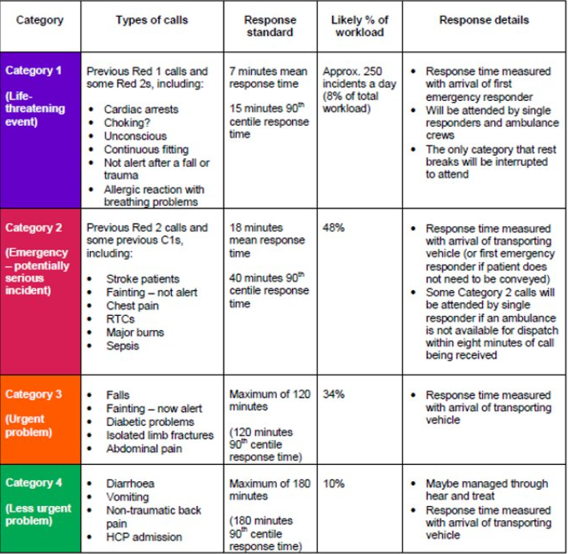
Containing a community crisis: an end of life perspective –
LAS call prioritisation

Slide 27
Containing a community crisis: an end of life perspective
What can we do?
The Mental Health Act (1983)
The Mental Capacity Act (MCA) 2005
https://ghc.nhs.uk/wp-content/uploads/Code-of-Practice-Easy-Read.pdf

Slide 28
Containing a community crisis: an end of life perspective
The Mental Capacity Act (2005)
The MCA empowers individuals to make their own decisions where possible and protects the rights of those who lack capacity.
Where an individual lacks capacity to make a specific decision at a particular time, the MCA provides a legal framework for others to act and make that decision on their behalf, in their best interests.
This includes decisions about their care and/or treatment
The MCA has five Key Principles which emphasise the fundamental concepts and core values of the Act. These must be considered and applied when you are working with, or providing care or treatment for, people who lack capacity.
MCA: Five Key Principles:
Every person must be assumed to have capacity unless it is proved otherwise.
People must be supported as much as possible to make a decision before anyone concludes that they cannot make their own decision.
A person should not be considered as unable to make a decision solely because they make an unwise decision.
Any act done, or decision made, on behalf of someone who lacks capacity must be done, or made, in their best interests.
Before making a decision, or acting on behalf of someone who lacks capacity, a decision maker must consider if the outcome could be achieved effectively in a less restrictive manner.

Slide 29
Containing a community crisis: an end of life perspective
Use of Restraint (1)
The law surrounding restraint is complex. It requires that any kind of restraint carried out is within a legal framework.
Mental Capacity Act (2005) and its amendments. Section 6(4) of the Act states that someone is using restraint if they;
Use force, or threaten to use force, to secure the doing of an act which the person resists, or
To restrict a person’s liberty of movement, whether they are resisting or not.
The main types of restraint are: physical, chemical, and environmental.

Slide 30
Containing a community crisis: an end of life perspective
Use of Restraint (2)
There must be legal power authorising the use of restraint. For example: using section 6 of the MCA 2005 provides lawful authority for restraint to be used (a) on a person who lacks capacity, where (b) it is reasonably believed to be necessary and proportionate to protect them from harm
This power must be legitimate and fall within one of 5 grounds. The majority of cases of restraint in the ambulance setting will fall under for the protection of health or morals
The power used must be appropriate for the aim
There must be a rational connection between the method of restraint used and the aim
The means of restraint and the duration it is applied must be necessary, and no more than necessary, to accomplish the aim
The end must justify the means

Slide 31
Containing a community crisis: an end of life perspective
The Mental Health Act (2007)
Section 135:
  Warrant for police to attend assessment
  Organised with AMHP and doctors
Section 136:
  Power for police to remove someone from public place to place of safety
  If they appear to be suffering from a mental disorder
Section 5(2):
  Doctors holding power in hospital
  Up to 72 hours
Section 5(4):
  Nurses holding power in hospital
  Up to 6 hours
  https://www.nhs.uk/mental-health/social-care-and-your-rights/mental-health-and-the-law/mental-health-act-easy-read/
The MHA is a law in England and Wales that allows people to be detained in a hospital against their will for assessment or treatment
Section 2:
  Assessment and treatment of mental disorder
  To be detained in hospital in the interest of the patient's own health or safety, or for the protection of others
  Two doctors (one must be s12 approved) and Approved Mental Health Professional (AMHP)
  28 days
Section 3:
  As above, usually
  6 months

Slide 32
Containing a community crisis: an end of life perspective
What is classified as a mental disorder?
MHA defines a mental disorder as any disability or disorder of the mind:
Includes a range of conditions:
  Schizophrenia, bipolar disorder, anxiety disorders, depression, eating disorders, personality disorders, and autistic spectrum disorders.
However, there are some exceptions to this definition:
Learning disabilities
  Not considered a mental disorder unless it's associated with abnormally aggressive or irresponsible behaviour.
Alcohol or drug dependence
  Alcohol or drug dependence is not considered a mental disorder, but a mental disorder can be associated with alcohol or drug use or cessation.

Slide 33
Containing a community crisis: an end of life perspective

Slide 34
Containing a community crisis: an end of life perspective

