Slide 1
Is there a role for Palliative Care in Relation to Eating Disorders
Dr Rob Freudenthal: Consultant psychiatrist in eating disorders
Dr Joanne brady: Consultant in palliative care

Slide 2
Disclaimer
Don't have all the answers
Share experiences and reflections
Review the literature and evidence
Generate a conversation

Slide 3
Overview
Share 2 cases
Reflect on these cases and invite your initial thoughts and feelings.
Consider is there a role for PC in managing people with Anorexia Nervosa
What does the literature and evidence tell us
What are the controversies and risks
Look at the arguments for and against
If there is a role then HOW do we do it, WHAT do we do
What is the same, what is different
Invite your stories, reflections and discussion

Slide 4
Case 1

Slide 5
What are your initial thoughts and reflections on this case?

Slide 6
Palliative Care Team reflections
None of our team had ever supported EoL care for someone with AN
Inconsistent with wishes yet huge life limiting consequences
Felt chaotic and uncomfortable – outside our comfort zone
But what if she died badly…..
Lacked boundaries despite best efforts
“governance nightmare”
Prognostication clearly hard
Are we best placed to manage the symptoms eg agitation in this context?

Slide 7
ED Team reflections
ED team learnt a lot
There are limits to coercive treatment
For her it seems she had to hit “palliative care” to accept self responsibility regarding feeding
Helped to shift her to restarting some form of nutrition

Slide 8
Case 2
Notes:
Imagine our joy
Here we go again

Slide 9
What are your initial thoughts and reflections on this case?

Slide 10
Palliative Care Team Reflections
Older – 55
Physically frail, less resilience, globally deteriorating
Deteriorating despite high quality care and exhausted treatment options
She was consistent with her wishes
Good communication with teams – felt joined up
Pall care interventions
Sx, ACP, MDT, care, equipment, communication, EoL support
Good outcome
Died at home, cared for and listened to.

Slide 11
ED Team reflections
Should they have referred sooner?
ED team continued to visit in the community once palliative care were involved
It felt the right thing to do
They are used to caring for people who recover not who are dying
Big ask for the team to see this.
Hospice team did a post death debrief which was valuable

Slide 12
Is there a role for Palliative Care in Relation to Eating Disorders A Psychiatrists perspective
Dr Rob Freudenthal: consultant psychiatrist in eating disorders

Slide 13
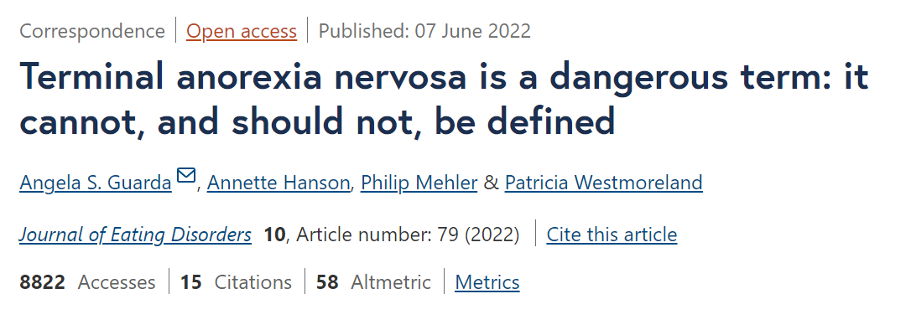
Controversies in relation to ‘terminal anorexia’ and provision of palliative care

Slide 14
Proposed sub-diagnosis of terminal anorexia
Gaudiani set out proposed characteristics for making diagnosis of “terminal anorexia”
1) age over 30
2) prior persistent engagement in high-quality, multidisciplinary eating disorders care
3) decision-making capacity to understand further treatment is futile, the wish not to prolong life and acceptance of death
Gaudiani also explicitly linked this proposed sub-diagnosis to access to MAiD [medical aid in dying]
Makes argument that MAiD provides patients a choice in how they die, not whether they die
Note: one patient is a posthumous co-author of the paper

Slide 15
Mortality in anorexia nervosa
Standardised mortality ratio for anorexia nervosa usually estimated at ~5.5
However SMR in those admitted to eating disorder units 15.9 women, 22.4 men [in a French study)
Note: 26 y study of mortality in eating disorders 1974 - 2000
Mean lowest BMI of 9 patients who died of anorexia nervosa (as opposed to suicide or other causes) was 10.7 (range 9.1–12.4).
However: deaths according to ONS in England and Wales from AN is approximately 20 per year

Slide 16
Response to ‘terminal anorexia’ diagnosis
1) specific concerns with criteria
2) unintended harms
3) ethical concerns regarding linking of criteria to access to MAiD

Slide 17
The criteria
1) age over 30
This is arbitrary. Age is being used as a proxy for longevity of illness. Longevity of illness is not an accurate predictor of recovery.
2) prior persistent engagement in high-quality, multidisciplinary care
Who makes this judgement.
3) decision-making capacity to understand further treatment is futile, the wish not to prolong life and acceptance of death
While history can be used to inform a view about likely future responses to treatment, eating disorder treatment is change orientated and it is not possible to accurately predict treatment futility

Slide 18
Unintended harms
The relationship between medical authorities classifying illness, and the burden of illness in the population is complex and interdependent: i.e. the classification of an illness can create illness behaviours
Disciplines of anthropology and history of medicine illustrate this: eg hysteria in 19th century
For some patients, the nature of the psychopathology can include a powerful drive to be the thinnest [‘most malnourished’] – creating new categories for more severe malnutrition could further complicate/entrench the psychopathology of anorexia
It facilitates a route for “the anorexia to win” – this concern has been raised by many service user advocacy groups

Slide 19
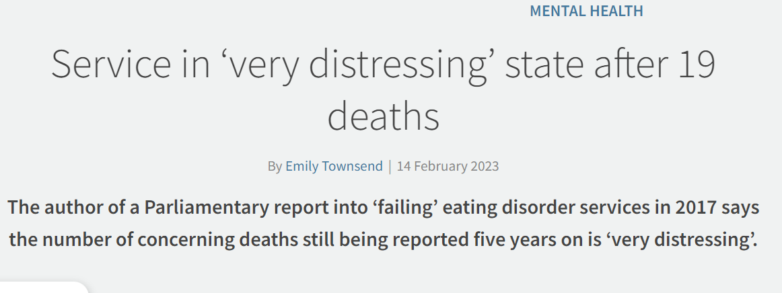
So where does this leave eating disorder services?

Slide 20
Some ‘real world realities’
Eating disorder treatment is change-orientated, and therefore at its core is collaborative
Most significant prognostic indicators of recovery are: voluntary treatment, and BMI at discharge
Treatment under the Mental Health Act has significant adverse effects:
Impact of deprivation of liberty
Entrenchment of the eating disorder [patients are doubly coerced, by the ED and the treatment]
Restraint feeding is not compatible with life in the longer term
Coercive treatment can only be provided within a time limited framework and with appropriate legal safeguards. Coercive treatment is not always successful.
Indefinite restraint feeding is not an available intervention that can be provided by services

Slide 21
Role of psychiatrist in this context
Hold hope/expectation that change is possible
Evaluate risk: note predictions of mortality should always be made acknowledging uncertainty
Consider use of MHA and role of coercive treatment, with patient and family/network
Try and reduce all barriers to accessing change
Identify additional needs that may need to be met, including palliative care needs:
Chronic pain
Non healing ulcers
Extreme frailty and mobility difficulties
Discussions about likely imminent death/funeral plans/spiritual needs etc
Support family, GP, other healthcare services

Slide 22
Is there a role for Palliative Care in Relation to Eating Disorders A Palliative Medicine perspective
Dr Joanne brady: consultant in palliative care

Slide 23
What does the literature tell us?
A case study
Anorexia nervosa: Palliative care of terminal psychiatric disease
Dr. Joseph O’Neill Dr. Tony Crowther Dr. Gwyneth Sampson
The American Journal of Hospice & Palliative Care November/December 1994

Slide 24
What did others think?
Education and debate in BMJ
Controversies in management
Does palliative care have a role in treatment of anorexia nervosa?
A recent report in a palliative care journal described a patient with longstanding and severe anorexia nervosa who was transferred from a psychiatric unit to a hospice, where she died.
Williams and colleagues argue that patients with anorexia nervosa should be actively treated.
Russon and Alison put the case for palliative care
BMJ 1998; 317 doi: https://doi.org/10.1136/bmj.317.7152.195 (Published 18 July 1998)

Slide 25
We should strive to keep patients alive Christopher J Williams, Lorenzo Pieri, Andrew Sims
1) Recovery is possible even in patients with longstanding severe anorexia.
2) Judgments may be clouded:
Depression
Cognition

Slide 26
Palliative care does not mean giving up Lynne Russon, Dawn Alison
1) Appropriateness of palliative care for anorectic patients
2) Effects of starvation on cognition and informed consent
3) Palliative care is not just terminal care

Slide 29
A parallel approach
Could we do the same for AN as for cancer and organ transplantation
If intent and goals are clear?
Can palliative care contribute without compromising survival chances

Slide 30
Are we treating AN different to other illnesses?
If so, why?
Is it because we see it as psychiatric not physical
Is the level of uncertainty about the outcome a step too far…
Is it our lack of familiarity makes it uncomfortable?

Slide 31
AN outcomes
Many recover
Many remain unrecovered but live with an acceptable QOL
Some cycle from crisis to stability
But some do die (varies 5-18% according to study)

Slide 32
Actual AN related deaths
Sudden:
Suicide
Electrolyte imbalance
Expected:
Malnutrition
Medical complications

Slide 33
“we do not expect people with progressive cancer to keep having treatment if it failed before and is ineffective, futile and harmful”

Slide 34
So how do we select the right people
Perhaps a subset of people with AN need palliative care BUT….
We don’t want to “palliate” those who can survive
We don’t want to miss the chance to enable a good death for those who can’t

Slide 35
“Staging” AN
No “staging” for AN
No consensus criteria
No specific bio prognostic parameters that accurately define/predict “terminal AN”
If we could define criteria then it would be easier for them to access palliative care support

Slide 36
Clinical characteristics of “terminal AN”

Slide 37
Following publication of the previous article, several opinions objecting to these criteria were published.
A further literature review was conducted – 5 themes identified
The goals of this article are to respond to the key themes of concern
Yager et al. Journal of Eating Disorders (2022) 10:135 https://doi.org/10.1186/s40337-022-00659-

Slide 38
Concerns & Responses
Labels are dangerous
Anorexia nervosa is a treatable disorder
A terminal psychiatric condition cannot be defined
The proposed definition is not specific enough
Capacity considerations in the criteria do not account for the psycho‑cognitive impairments in anorexia nervosa

Slide 39
Back to our cases
Case 1
Fitted 1/3 “criteria” – young, inconsistent wishes
Would I be surprised if…..
HOPE & WORRY
Did not have skills to manage her EOL care so asked for help
We supported with exploring wishes, planning, equipment, symptom management
Family, carers and team felt supported
She did not die

Slide 40
Back to our cases
Case 2
Fitted 3/3 “criteria”
Would I be surprised if…..
Did not have skills to mange her EOL care so asked for help
We supported with exploring wishes, planning, equipment, symptom management
Family, carers and team felt supported
She died peacefully

Slide 41
Yes, there is a role for PC in AN
People die, some deaths are “expected” and symptomatic
They deserve access to PC
ED teams need our support & expertise
Which pts
Challenges and controversies with defining criteria
Individualised decision making
Address that with communication between teams, explore goals

Slide 42
When should we be involved – EoL only or earlier
Care concordant with stage of illness
We don’t know enough about it – need more research, data.
We are good at sitting in the grey zone, holding uncertainty
We must learn from past mistakes – opioids and chronic pain

Slide 43
Who does what
Being clear WHAT our role is – ACP, Sx, equip, care, support
Who has the expertise e.g. agitation, psychological support specific to AN
What do we bring to the table and is it evidenced based
What is the same and what is different
ACP, Care, Equipment, Prognostication
Symptoms – pain, nausea, incontinence, reduced mobility
Symptoms – chronic pain, pancreatitis, fluid shifts, electrolyte imbalances, bradycardia

Slide 44
Communication underpins everything
Work closely with teams
– psychiatry, pall care, GP and DN
Lots of collaboration
Real time communication
Review goals if situation changes – plans can be undone

Slide 45
“People living with AN struggle with communication so medicalise it for example by starving or purging. So, requests for palliative care can also be a form of communication”

Slide 46
What do we need moving forwards
We need to explore and research models of care and evaluate them
We need compassionate evidence-based guidelines and apply them individually
We need to work closely and collaboratively with our ED colleagues and learn from each other
We need conversations, training and education to better understand and address the needs of this patient population.

