Slide 1
People with severe mental illness: A marginalised group who die very young with complex palliative care needs
Professor Julia Verne
Visiting Professor
Cicely Saunders Institute of Palliative Care, Policy & Rehabilitation
King’s College London

Slide 2
Acknowledgements
The National Mental Intelligence Network and
National End of Life Care Intelligence Network at OHID DHSC

Slide 3

Stigma or blinkers?
The 2022 Lancet Commission into ending stigma and discrimination in mental health described the impacts of stigma and discrimination and urged that
“It is time to end all forms of stigma and discrimination against people with mental health conditions, for whom there is double jeopardy: the impact of the primary condition and the severe consequences of stigma”. Thornicroft G, Sunkel C, Alikhon Aliev A, et al.
The 2013 NCEPOD Measuring the Units (ARLD) report proposed stigma and attitudes could explain some of the variation seen in admission to intensive care units.

Slide 4
Background
Severe Mental Illness (SMI) refers to mental health disorders that are chronic, impair function, and require ongoing treatment
People with Severe Mental Illness includes diagnoses of:
Schizophrenia, Psychosis and Bipolar Disorder
People with Severe Mental Illness (SMI) die on average 20 years younger than people without
2/3 die from physical conditions
There are no registers so for this work ‘people with SMI’ refers to people 18 to 74 in contact with mental health services. It is a proxy measure.

Slide 5
Some soundbites on premature (<75) mortality in adults with severe mental illness (SMI)
Pre-pandemic ~ 35,000 deaths per year c.f. 35,000 lung cancer deaths (UK)
Pre-pandemic premature mortality rate was ~5x higher in people with SMI than people without.
57% were male, ~40% <60 years.
Almost 3x more people with SMI died in the most deprived quintile of areas of residence than the least
4x difference in premature mortality rates for SMI across Government Administrative Areas, higher in the north of England and urban areas

Slide 6
People with severe mental illness have physical health needs ++
Intersectional compounding of demographic risk factors

Slide 7
People with severe mental illness have physical health needs ++
Intersectional compounding with demographic risk factors

Slide 8
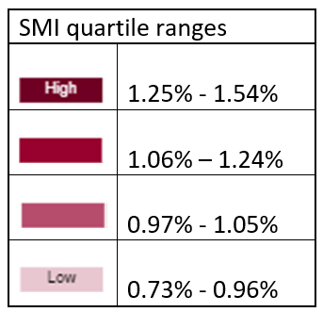
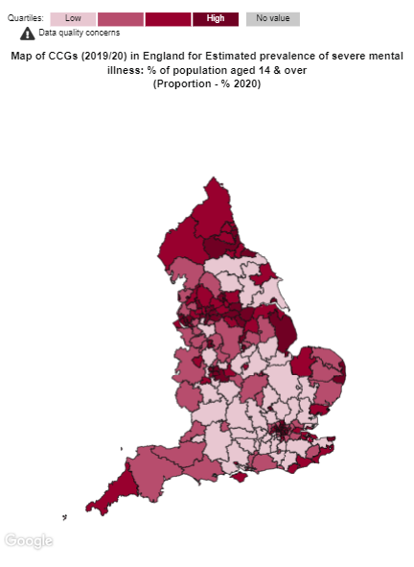
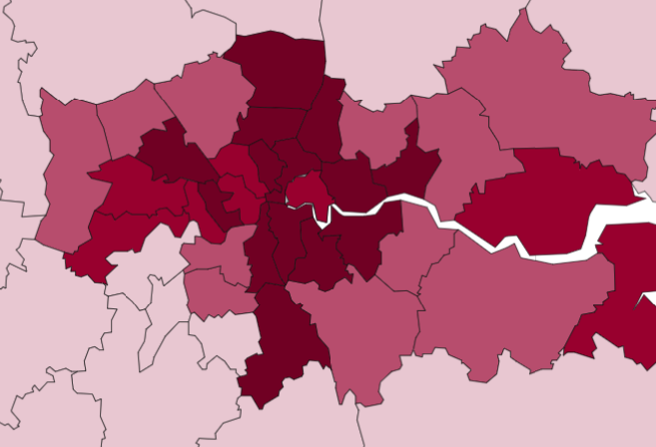
Geographical Variation in SMI estimated prevalence rates by CCG
England 1.1% 2019

Slide 9
Prevalence of SMI and variation by socio-demography
Variable | Breakdown | Numerator | Denominator | Prevalence %
 | England SMI | 100203 | 9305308 | 1.08
Deprivation | Quintile 1 (most deprived) | 30315 | 1759533 | 1.72
 | Quintile 2 | 23941 | 1921409 | 1.25
 | Quintile 3 | 18080 | 1798466 | 1.01
 | Quintile 4 | 14957 | 1858040 | 0.80
 | Quintile 5(least deprived) | 12910 | 1967860 | 0.66
Ethnicity | Asian | 7790 | 824138 | 0.95
 | Black | 9051 | 402376 | 2.25
 | Mixed | 2387 | 152728 | 1.56
 | Other | 1273 | 135610 | 0.94
 | White | 79702 | 7790456 | 1.02
Age | 14 to 24 | 4070 | 1496031 | 0.27
 | 25 to 49 | 43564 | 3869528 | 1.13
 | 50 to 64 | 30431 | 2056839 | 1.48
 | 65 AND OVER | 22138 | 1882910 | 1.18
Sex | Female | 47635 | 4669592 | 1.02
 | Male | 52568 | 4635716 | 1.13

Slide 10
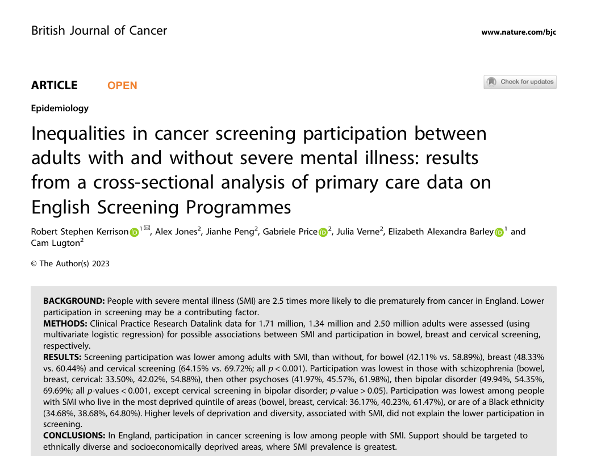
Intersectionality of disadvantage in access to health services for people with SMI

Slide 11
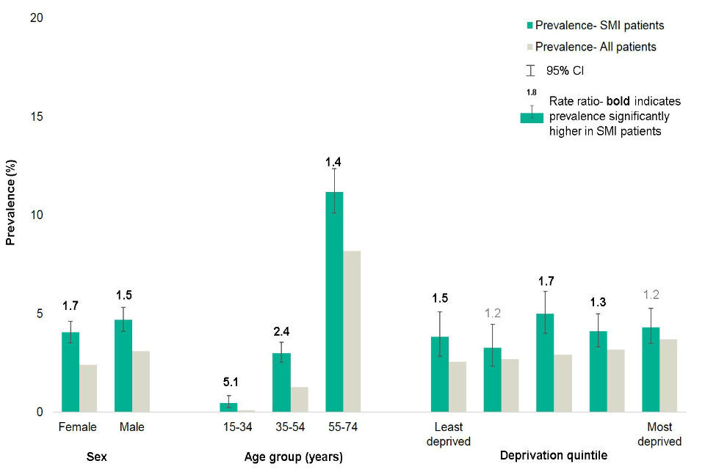
People with SMI have poorer physical health than general population
People with SMI compared to the general population
Have a higher prevalence of obesity, asthma, diabetes, COPD, CHD, stroke and HF
For people with SMI the prevalence is:
  1.8 higher for obesity
  1.2 higher for asthma
  1.9 higher for diabetes
  2.1 higher for COPD
  1.2 higher for CHD
  1.6 higher for stroke
  1.5 higher for HF
Multi-morbidity is common
Prevalence (age and sex standardised) of
3 and more physical health co-morbidities
in people with severe mental illness (SMI) c.f.
all people aged 15 to 74
Severe mental illness (SMI) and physical health inequalities - GOV.UK (www.gov.uk)

Slide 12
Two key indicators: national and local
premature mortality rate in adults with SMI - this is the number of people with SMI who die between the ages 18 and 74 per 100,000, calculated as an average for a 3 year period – it is presented as a directly standardized rate
excess mortality rate in adults under 75 with SMI - this measures the difference in premature mortality rate between people with SMI and those without SMI, calculated for a 3 year period – it is presented as a ratio
Notes:
NOTES
This study describes the temporal relationship between first recorded diagnosis of schizophrenia, bipolar disorder, and other non-organic psychotic illness and 24 chronic health conditions from 5 years before to 5 years after severe mental illness diagnosis. 5 years before diagnosis, people with schizophrenia had increased odds of three conditions, people with bipolar disorder 12 conditions, and people with other psychoses ten conditions compared with the matched cohort. At diagnosis, people with schizophrenia had increased odds of five chronic health conditions compared with the matched cohort, and individuals with bipolar disorder and other psychoses had increased odds of 15 conditions. By 5 years after diagnosis of a severe mental illness, this number had increased to 13 conditions for schizophrenia, 19 for bipolar disorder, and 16 for other psychoses. Patients with schizophrenia frequently had lower odds of receiving a chronic physical condition diagnosis than the matched cohort, suggesting underrecording in this subgroup. At the date of receiving a schizophrenia diagnosis, cardiac arrhythmias, myocardial infarction, cancer, renal disease, peptic ulcer, rheumatic disease, hypertension, peripheral vascular disease, and valvular disease were recorded less frequently than would be expected. This study therefore highlights when intervention is necessary to tackle the excess morbidity observed in the patients with a severe mental illness.

Slide 13
Premature mortality in adults with SMI over time

Slide 14
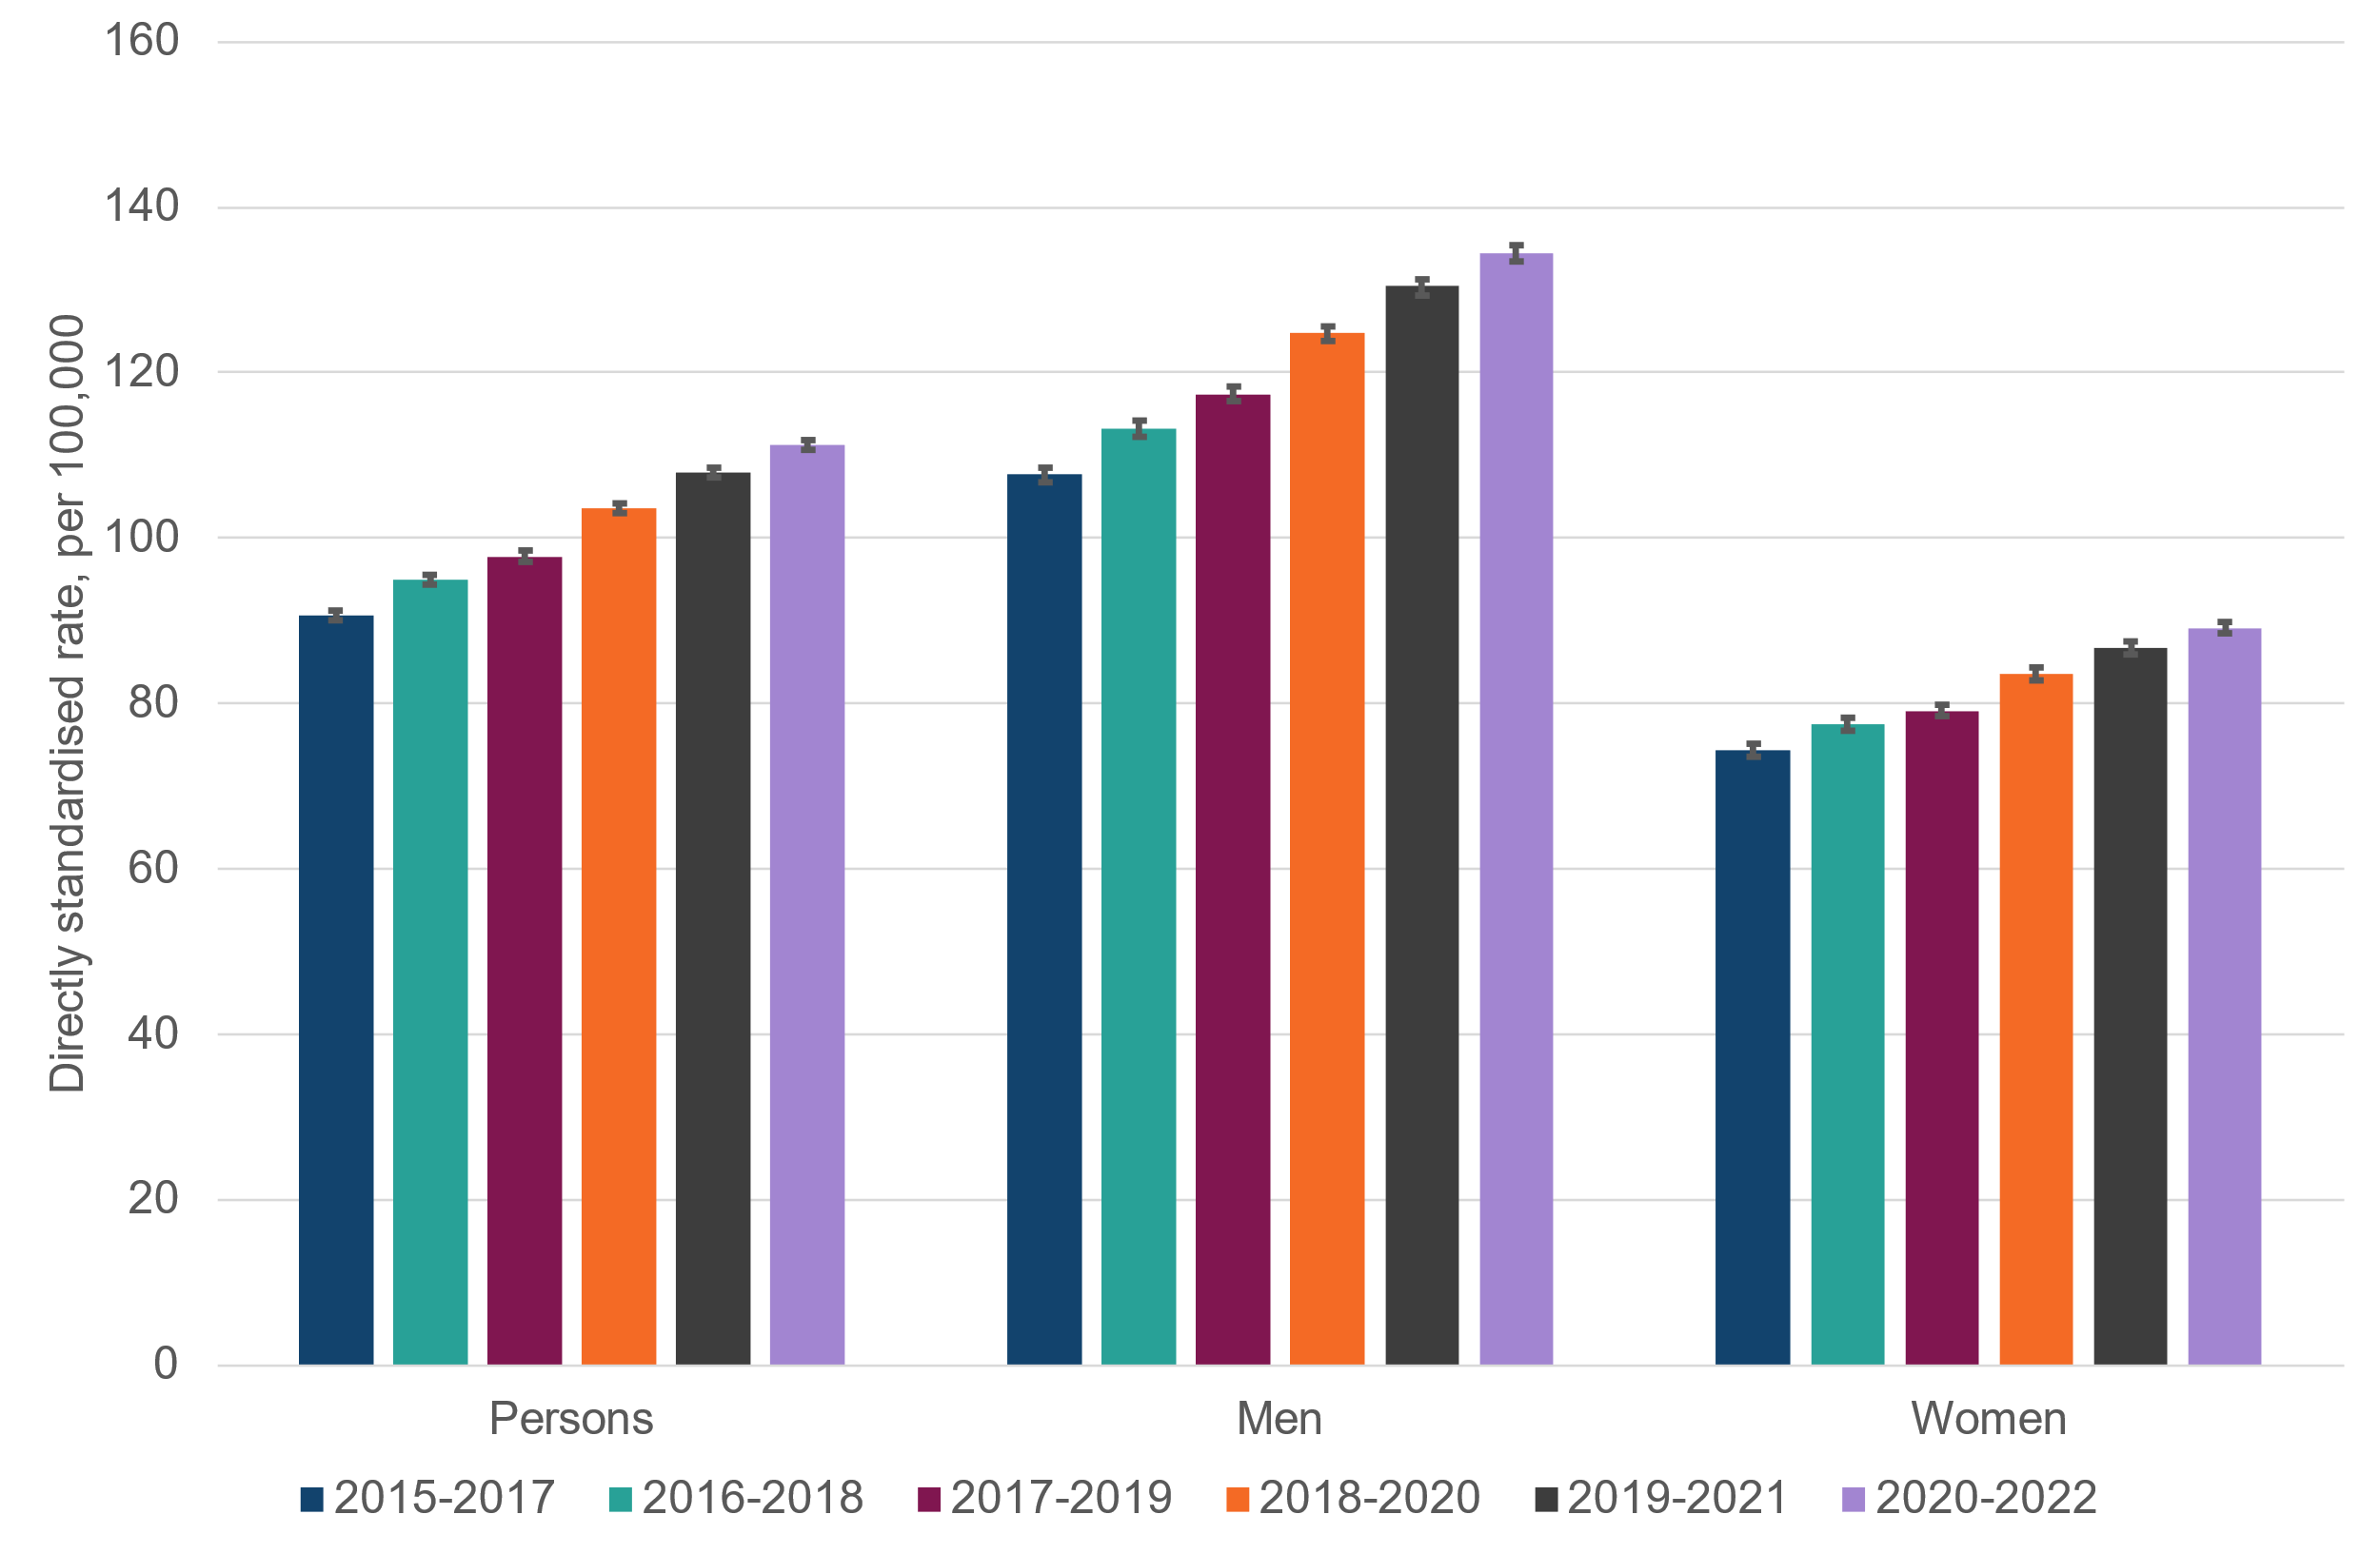
Change in premature mortality in adults with SMI by sex, England
Between 2015 and 2017 100,475 adults with SMI died prematurely (33,500 per year)
Between 2020 and 2022 130,400 adults with SMI died prematurely (43,500 per year)
N.B COVID-19
EXTRA 10,000 deaths per year

Slide 15
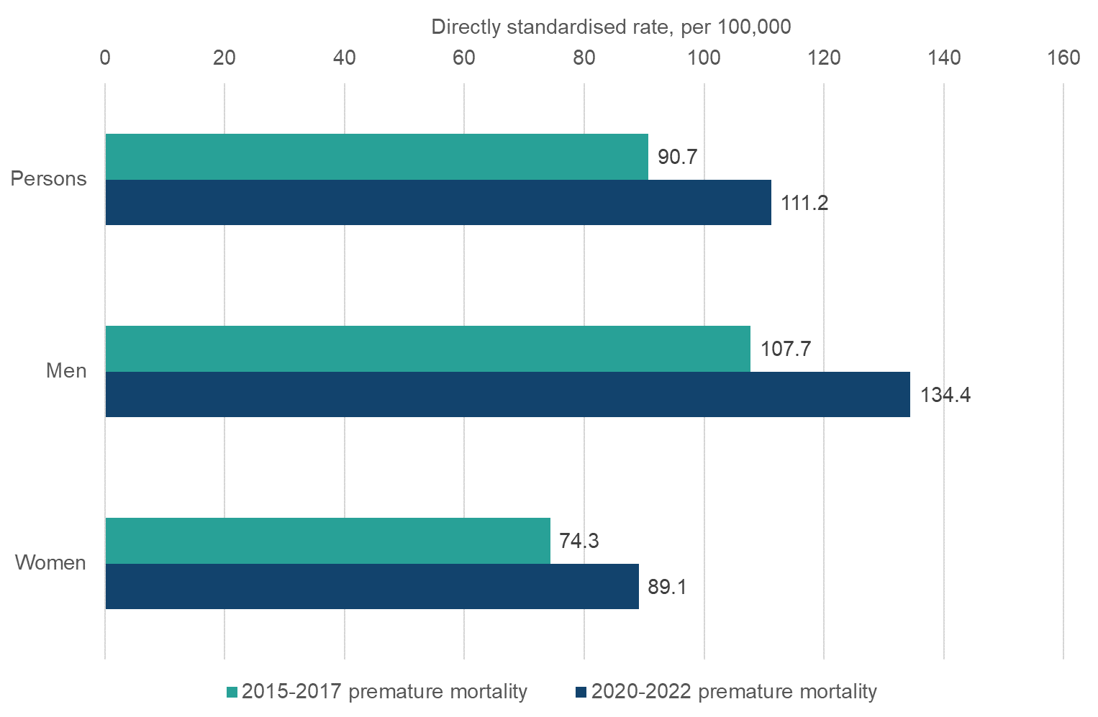
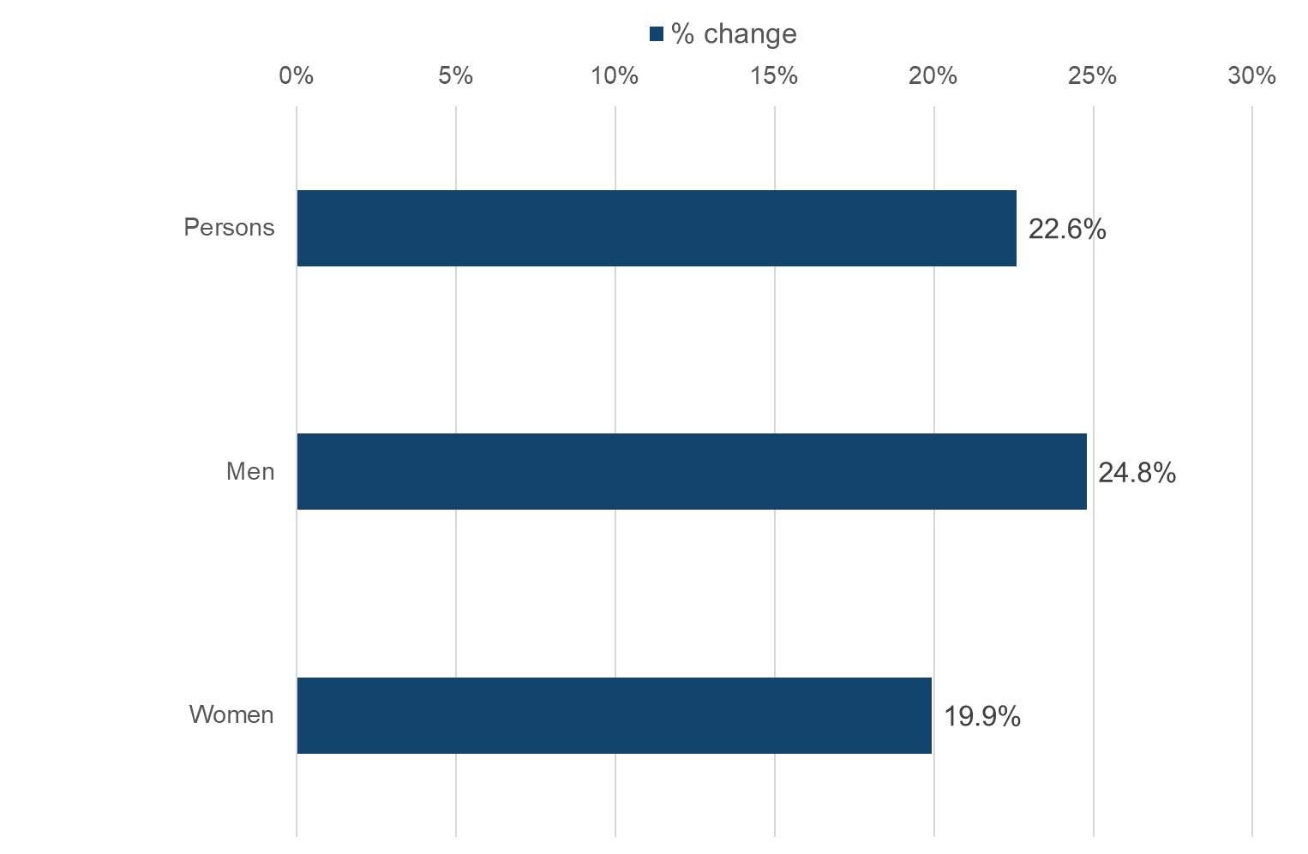
Premature mortality in adults with SMI by sex, England,
2015 to 2017 compared to 2020 to 2022, and % change

Slide 16
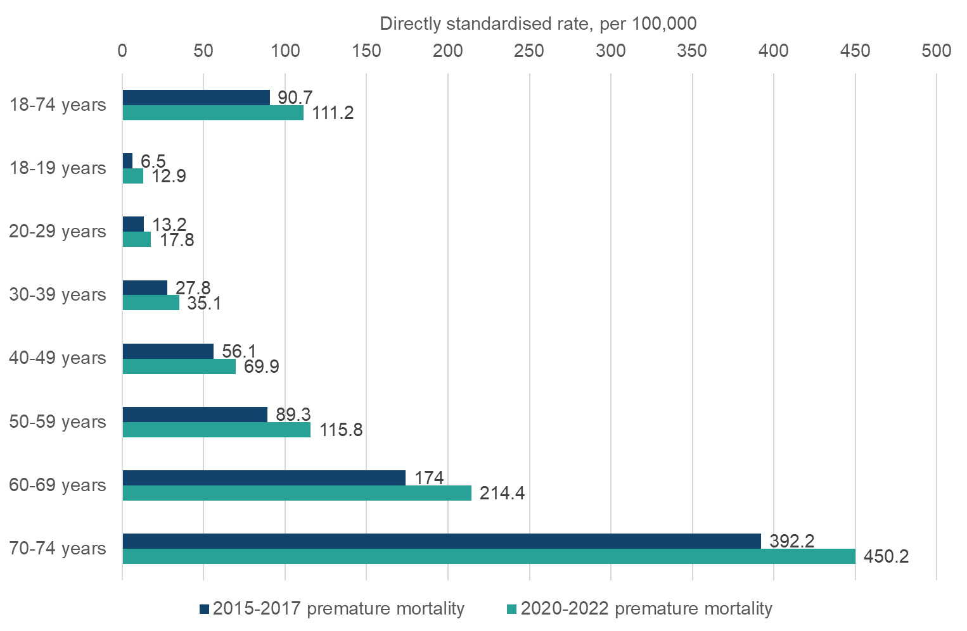
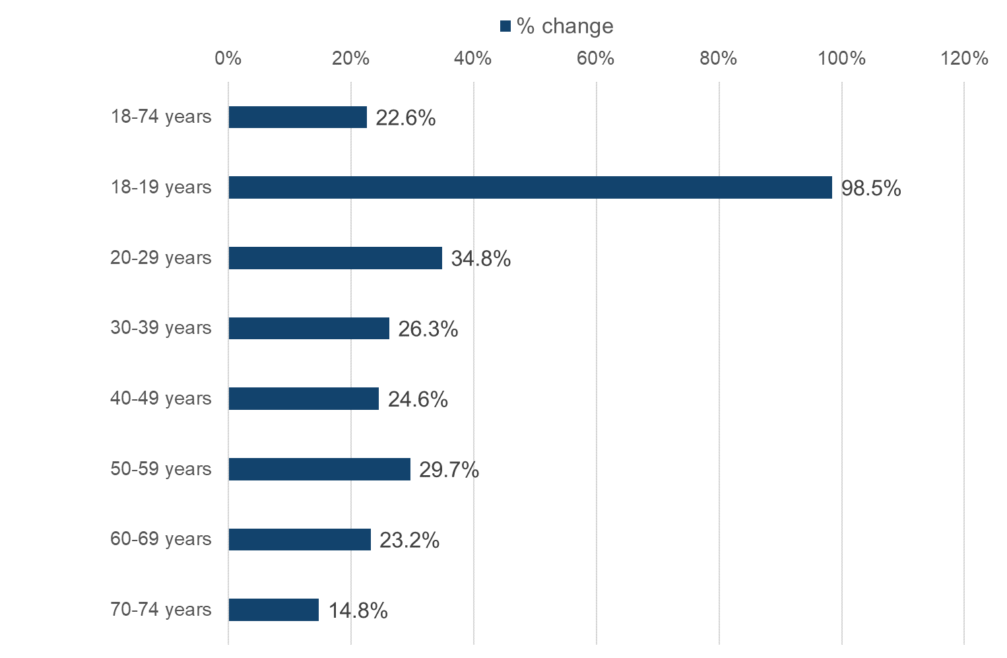
Premature mortality in adults with SMI by age group, England,
2015 to 2017 compared to 2020 to 2022, and % change

Slide 17
Variation in premature mortality in adults with SMI by deprivation and over time

Slide 18
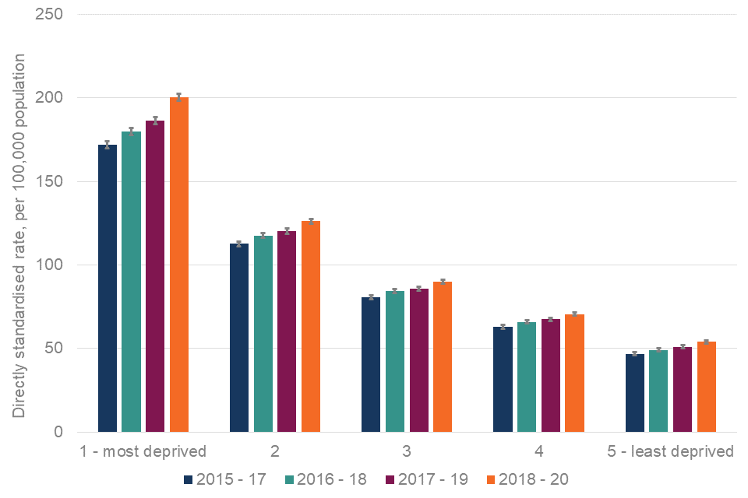
Premature mortality in adults with severe mental illness (IMD, 2015 to 2017 through to 2018 to 2020) in England –
N.B. COVID-19
Notes:
NOTES
This study describes the temporal relationship between first recorded diagnosis of schizophrenia, bipolar disorder, and other non-organic psychotic illness and 24 chronic health conditions from 5 years before to 5 years after severe mental illness diagnosis. 5 years before diagnosis, people with schizophrenia had increased odds of three conditions, people with bipolar disorder 12 conditions, and people with other psychoses ten conditions compared with the matched cohort. At diagnosis, people with schizophrenia had increased odds of five chronic health conditions compared with the matched cohort, and individuals with bipolar disorder and other psychoses had increased odds of 15 conditions. By 5 years after diagnosis of a severe mental illness, this number had increased to 13 conditions for schizophrenia, 19 for bipolar disorder, and 16 for other psychoses. Patients with schizophrenia frequently had lower odds of receiving a chronic physical condition diagnosis than the matched cohort, suggesting underrecording in this subgroup. At the date of receiving a schizophrenia diagnosis, cardiac arrhythmias, myocardial infarction, cancer, renal disease, peptic ulcer, rheumatic disease, hypertension, peripheral vascular disease, and valvular disease were recorded less frequently than would be expected. This study therefore highlights when intervention is necessary to tackle the excess morbidity observed in the patients with a severe mental illness.

Slide 19
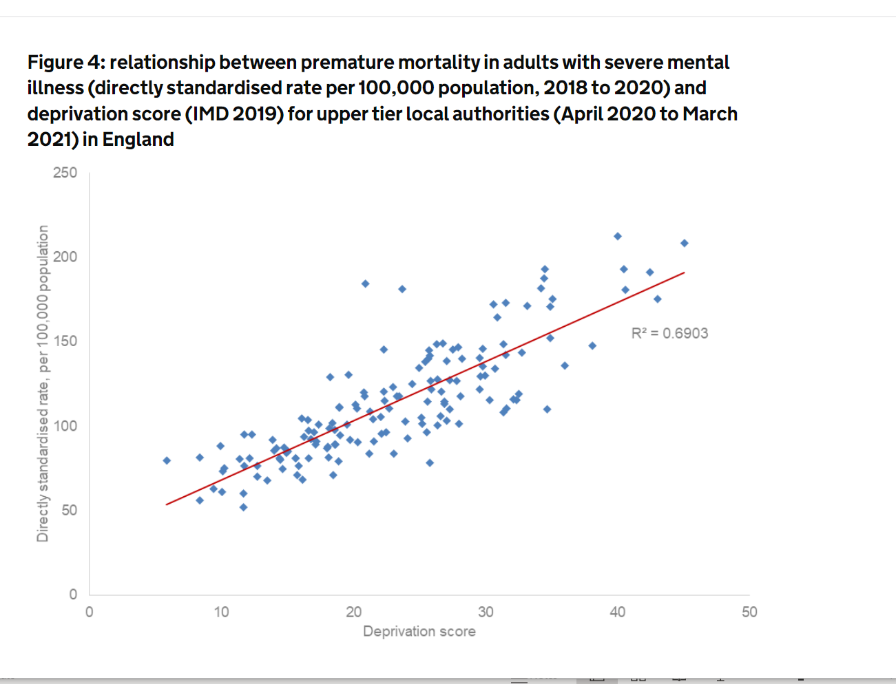

Slide 20
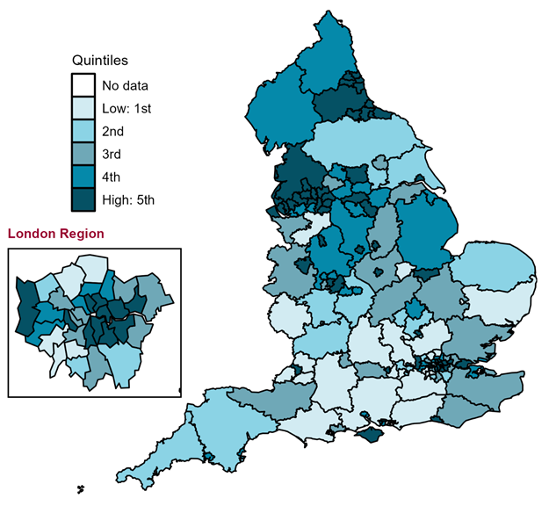
Premature mortality in adults with SMI, 2018 to 2020
In England between 2018 and 2020, the DSR for premature mortality in people with SMI was 104 per 100,000 adults.
There is 4-fold variation across England
52 per 100,000 in Oxfordshire to
212 per 100,000 in Manchester.
Notes:
NOTES
Map of upper tier local authorities in England for Premature Mortality/Directly standardised rate - per 100,000
Premature mortality in adults with SMI​
The absolute impact of mortality to help us understand where in the country people with SMI are at highest risk of dying early​
Definitions used:
Premature mortality in adults​
Any death where the deceased was aged between 18 and 74​ a.k.a. adults dying young​
Severe Mental Illness
Anyone with a referral to secondary mental health services in the five years before death

Slide 21
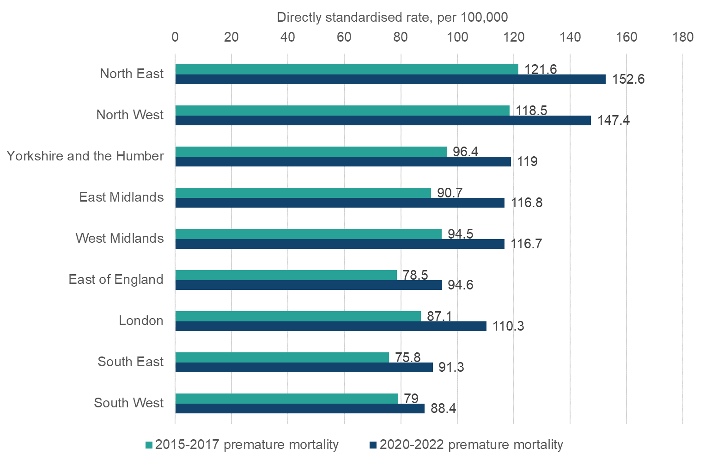
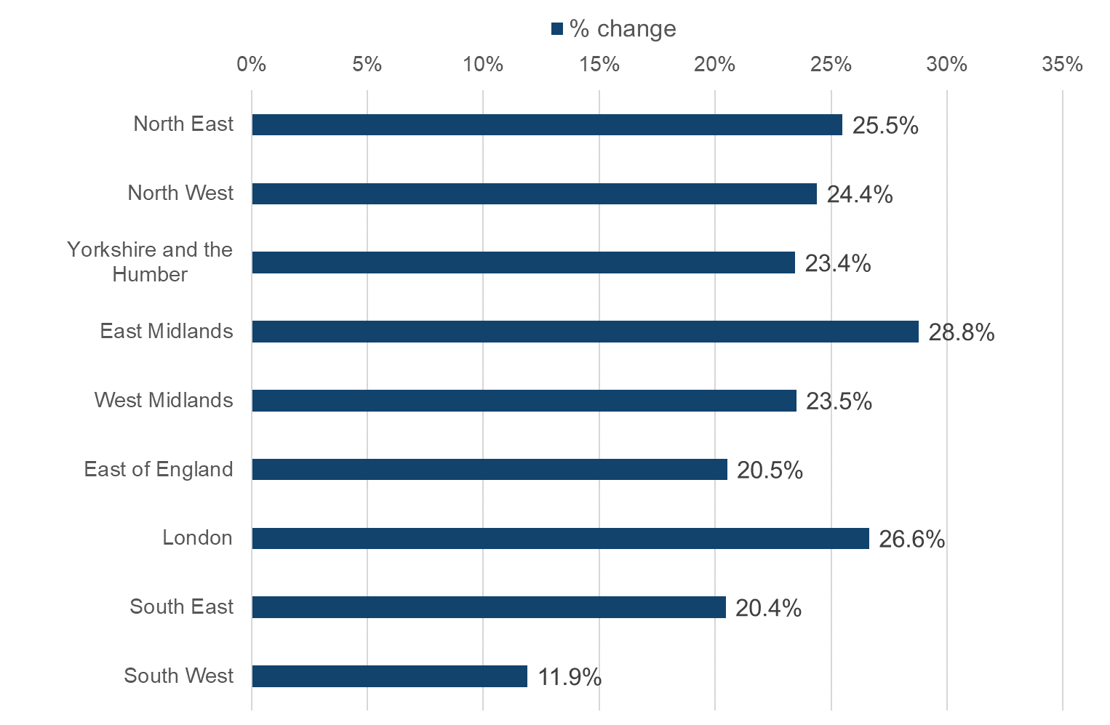
Premature mortality in adults with SMI by region, England,
2015 to 2017 compared to 2020 to 2022, and % change

Slide 22
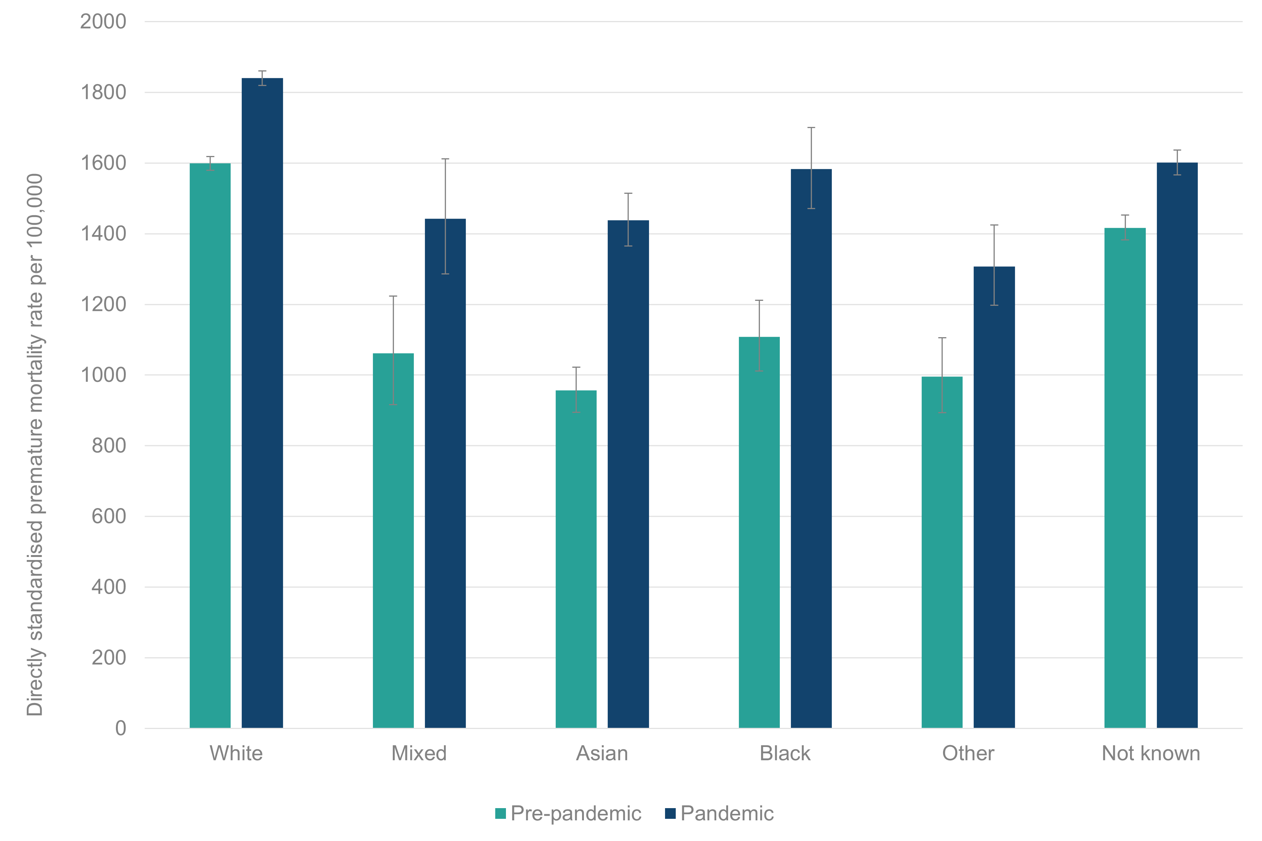
Premature mortality rate before and during the COVID-19 pandemic in people with SMI, by ethnicity https://www.gov.uk/government/publications/premature-mortality-during-covid-19-in-adults-with-severe-mental-illness

Slide 23
Condition specific premature mortality in adults with SMI

Slide 24
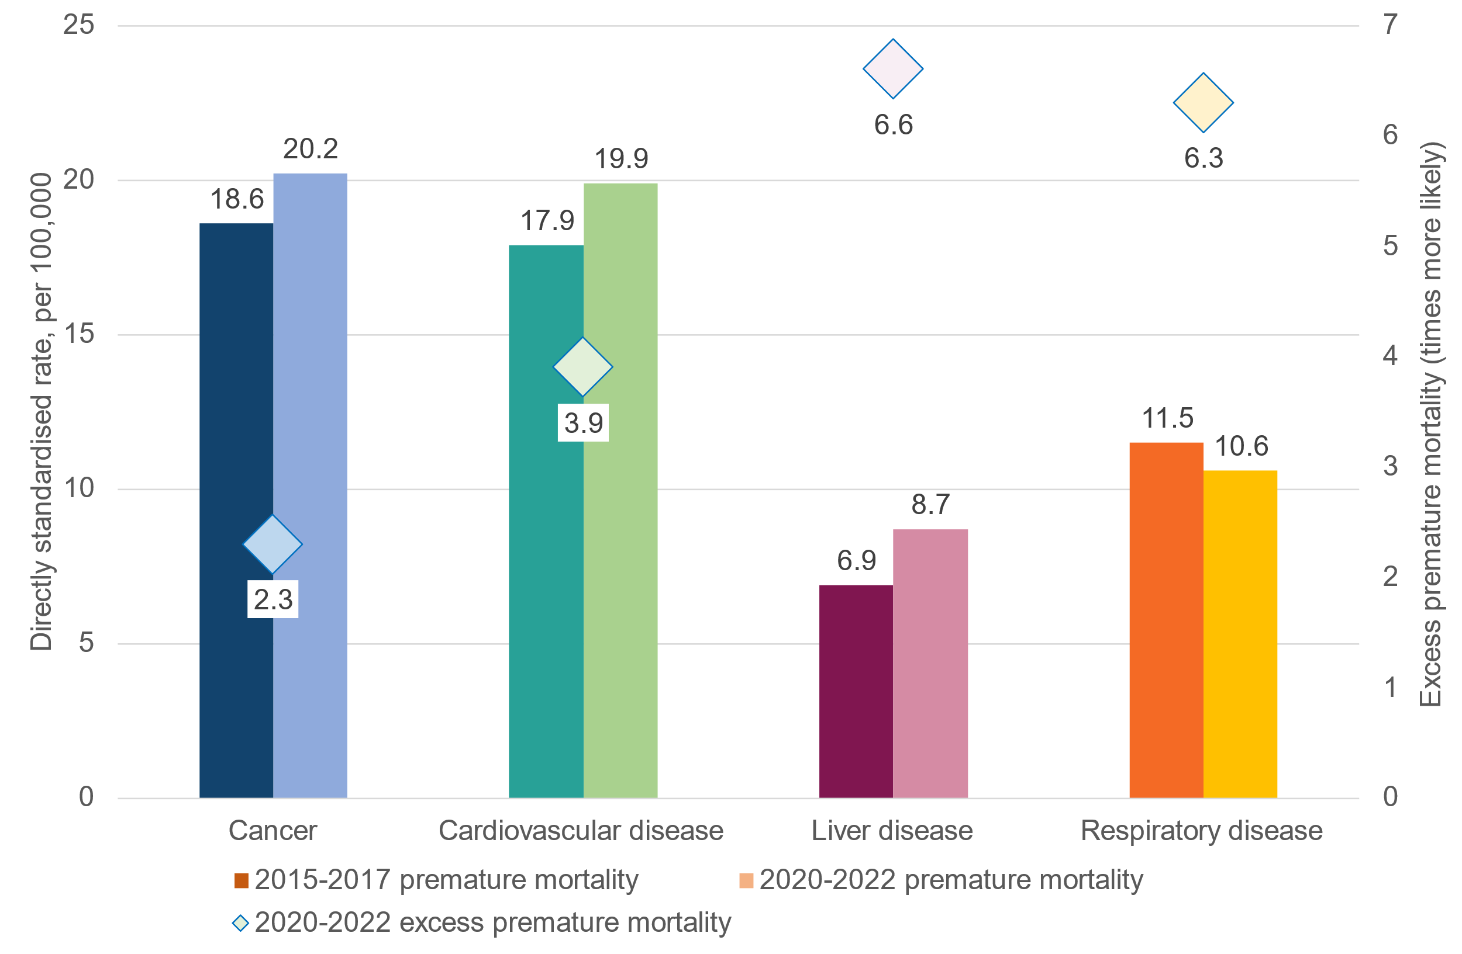
Premature mortality and excess premature mortality in adults with SMI, England, 2015 to 2017 compared to 2020 to 2022
For specific conditions, in the three years 2020 to 2022:
23,250 adults with SMI 18 to 74 died from cardiovascular disease, almost 7,800 per year.
23,600 adults with SMI 18 to 74 died from cancer, almost 7,900 per year.
10,100 adults with SMI 18 to 74 died from liver disease, almost 3,400 per year.
12,400 adults with SMI 18 to 74 died from respiratory disease, over 4,100 per year.

Slide 25
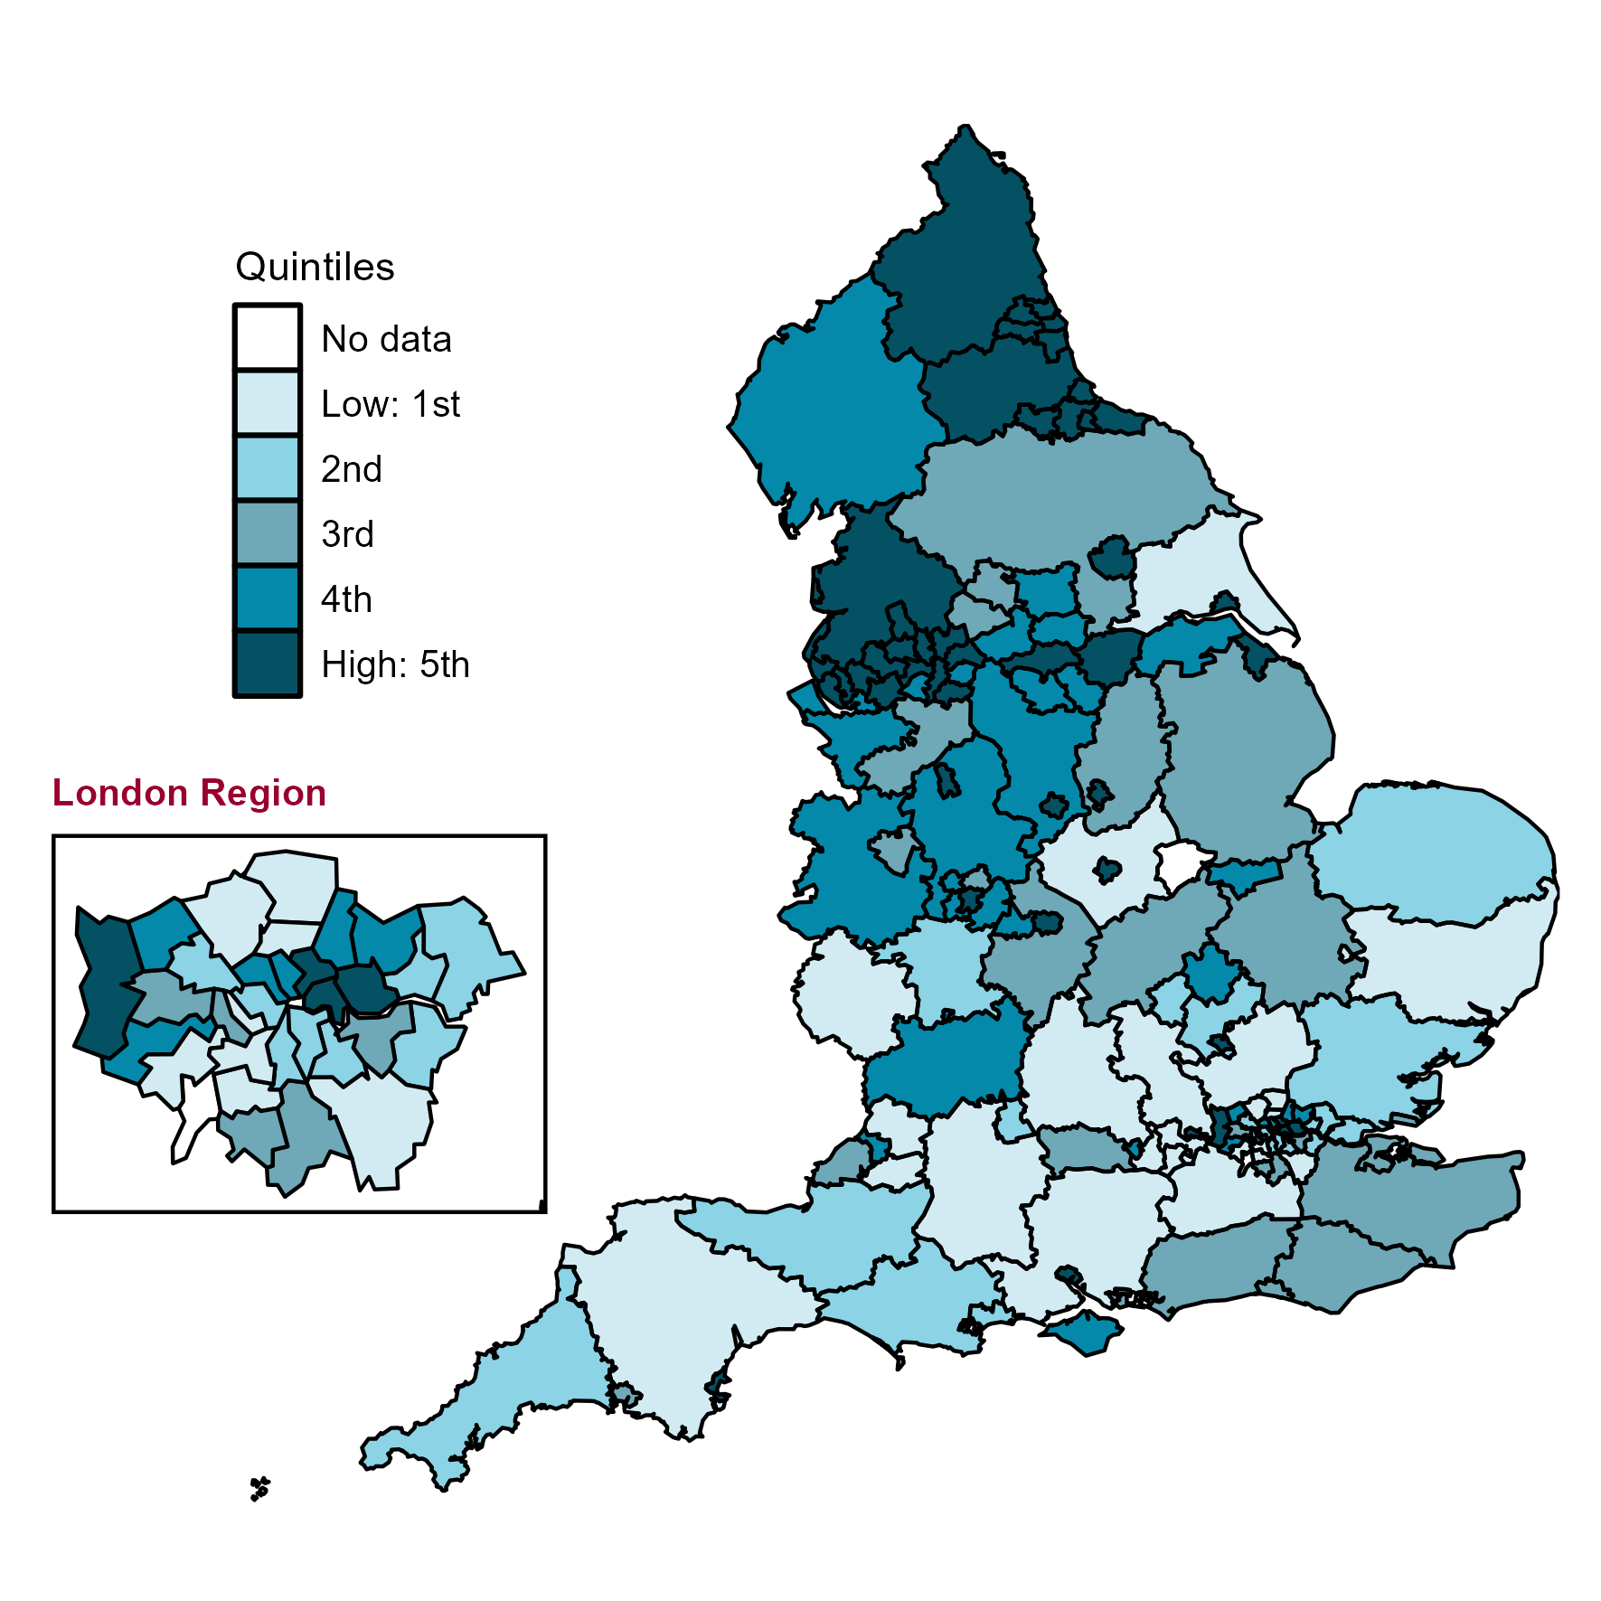
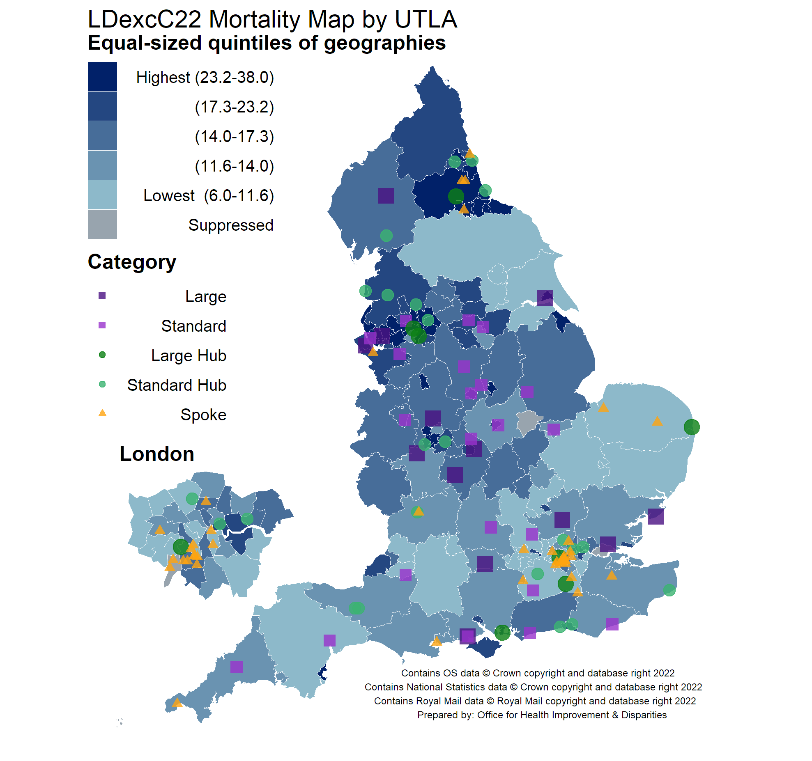
Geographic variation in premature mortality rate in adults with
SMI (L) and all patients ® dying due to liver disease, England
2020-2022
2020
Count
(13)
(22)
(7)
(20)
(29)

Slide 26
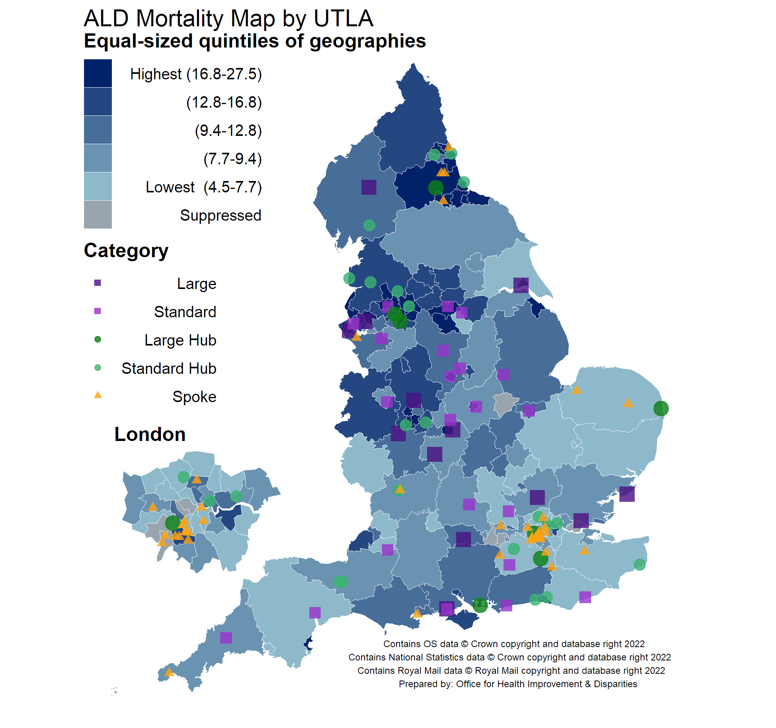
Premature mortality from Alcohol related liver disease

Slide 27
Excess premature mortality in adults with SMI

Slide 28
Excess premature mortality in people with SMI (2020 – 2022)
Adults with SMI are 4.86 times more likely to die prematurely than adults who do not have SMI (statistically significant) an average of 43,500 premature deaths per year
Women with SMI are 5.01 times more likely to die prematurely than women who do not have SMI (statistically significant) an average of 17,905 female premature deaths per year
Men with SMI are 4.84 times more likely to die prematurely than men who do not have SMI (statistically significant) an average of 25,560 male premature deaths per year
Adults with SMI are statistically significantly more likely to die prematurely than adults who do not have SMI in every Upper Tier Local Authority in England 4x variation
Notes:
NOTES
This study describes the temporal relationship between first recorded diagnosis of schizophrenia, bipolar disorder, and other non-organic psychotic illness and 24 chronic health conditions from 5 years before to 5 years after severe mental illness diagnosis. 5 years before diagnosis, people with schizophrenia had increased odds of three conditions, people with bipolar disorder 12 conditions, and people with other psychoses ten conditions compared with the matched cohort. At diagnosis, people with schizophrenia had increased odds of five chronic health conditions compared with the matched cohort, and individuals with bipolar disorder and other psychoses had increased odds of 15 conditions. By 5 years after diagnosis of a severe mental illness, this number had increased to 13 conditions for schizophrenia, 19 for bipolar disorder, and 16 for other psychoses. Patients with schizophrenia frequently had lower odds of receiving a chronic physical condition diagnosis than the matched cohort, suggesting underrecording in this subgroup. At the date of receiving a schizophrenia diagnosis, cardiac arrhythmias, myocardial infarction, cancer, renal disease, peptic ulcer, rheumatic disease, hypertension, peripheral vascular disease, and valvular disease were recorded less frequently than would be expected. This study therefore highlights when intervention is necessary to tackle the excess morbidity observed in the patients with a severe mental illness.

Slide 29
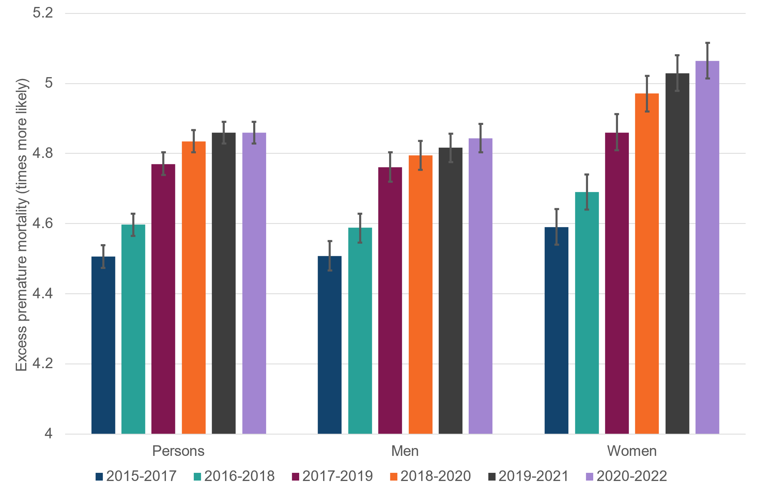
Change in excess premature mortality in adults with SMI by sex, England

Slide 30
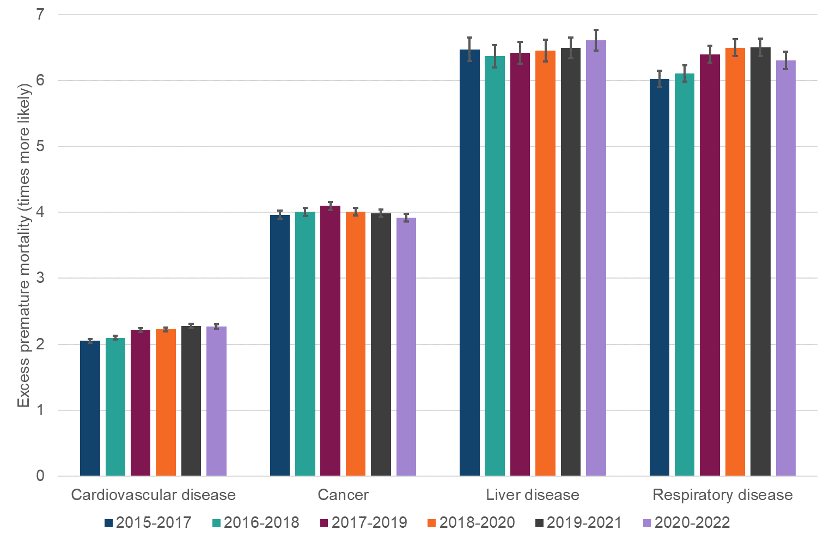
Change in excess premature mortality in adults with SMI by cause of death, England

Slide 31
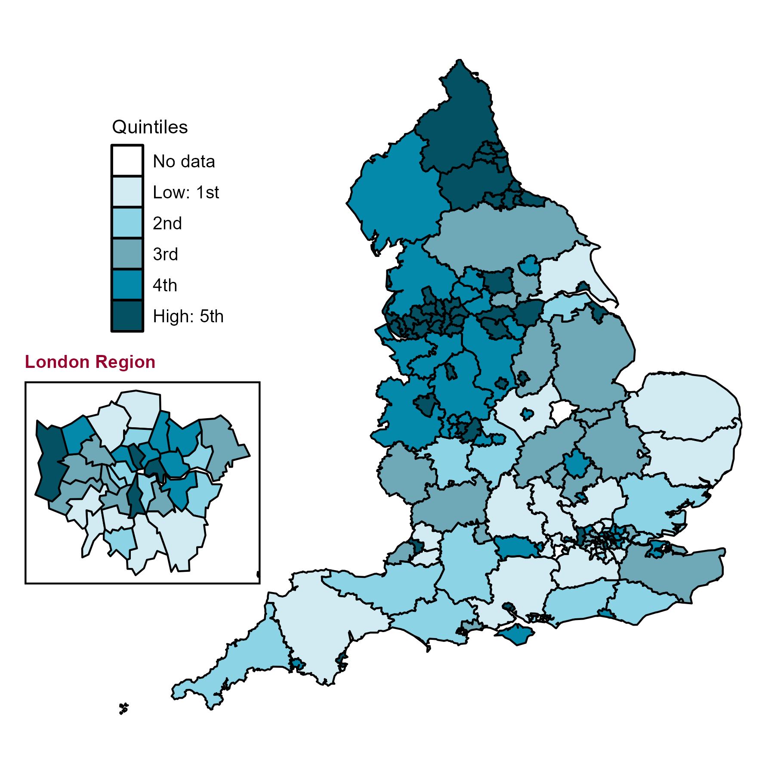
Excess premature mortality due to liver disease in adults with SMI, 2018 to 2020
Across local areas in England, excess premature due to liver disease in adults with SMI ranged from 2 to 14
Notes:
NOTES
Map of upper tier local authorities in England for Premature Mortality/Directly standardised rate - per 100,000
Premature mortality in adults with SMI​
The absolute impact of mortality to help us understand where in the country people with SMI are at highest risk of dying early​
Definitions used:
Premature mortality in adults​
Any death where the deceased was aged between 18 and 74​ a.k.a. adults dying young​
Severe Mental Illness
Anyone with a referral to secondary mental health services in the five years before death

Slide 32
The impact of the first year 2020 of the COVID-19 Pandemic on people with SMI aged 18-74
22.2% increase on previous annual number of deaths ~43,000
7,785 people with SMI aged 18-74 died from COVID-19.
7,460 people with SMI aged 18-74 died from cancer an increase of 7%.
6,925 people with SMI aged 18-74 died from cardiovascular disease an increase of 12%
3,450 people with SMI aged 18-74 died from respiratory a reduction of 15%
2,795 people died from Liver Disease an increase of 28%,
ArLD increased 40%
ArLD accounted for 78.2% of premature deaths from liver disease in people with SMI
compared with 67.5% in people without SMI
The proportion of premature liver disease deaths due to ArLD in people with SMI prior to the pandemic was 71.6%
1,510 people with SMI died from accidental drug poisoning an increase of 22% Death by SUICIDE Increased

Slide 33
Parity of esteem means that end-of-life care for people should be of equal quality for people with severe mental illness to that experienced by all.

Slide 34
Background: Inequalities in end of life care
Most people with SMI have at least two major conditions at death (SMI plus a physical cause) deprivation add sociological challenges and SMI is a barrier to healthcare access(Verne J. et al, 2024)
Recent systematic review found conflicting evidence for the association between SMI and end-of-life care, although different patient groups, settings and measures were used. People with SMI were more likely to die in care homes than the general population. There were no patterns for other places of death (Wilson R. et al, 2020)
End of life care lacking for SMI patients with cancer due to stigma and discrimination. They experienced poorer levels of physical, psychological and spiritual care(Grassi L, 2020)
In Hong Kong the rate of receipt of palliative care in patients with SMI was 0.5%, compared with 1.72% of the general population (Chang KY et al, 2023)
Patient, clinician, and system-level factors all contribute to disparities including decreased access to palliative care, uneven continued engagement with mental health services, and low rates of advance care planning (Shaley D. et al, 2020)
UK qualitative study looked at SMI patients and carers views of accessing PEoLC. Themes emerging includes stigma and prejudice, staff being hesitant to discuss EoLC, and not listening to carers (Jerwood J.et al, 2021)

Slide 35
Background: Advance Care Planning
Studies of palliative care tools and interventions for people with SMI are scarce. The existent tools and intervention need further development and should be tailored to the care needs and settings of these people. Further research is needed on the feasibility, usability and effects of tools and interventions for palliative care for people with SMI. (Den Boer K. et al, 2019)
People with SMI not accustomed to communicate about end of life and dying. They were not engaged in future palliative care planning for patients with SMI (Knippenberg et al , 2013)
ACP tools and discussions should be adapted to meet the needs of patients with SMI – more gradual approach required (Knippenberg et al , 2013)
Significant correlations with impaired decision-making capacity included duration of mental illness of 30-39 years, diagnosis of schizophrenia spectrum disorders and being admitted involuntarily. 65% were able to engage in ACP (Kotze C et al, 2021)

Slide 36
Place of death

Slide 37
Place of death for people with
Severe Mental Illness (SMI)
Methodology
Description | ICD10 code
Schizophrenia | F20
Schizotypal disorder | F21
Persistent delusional disorders | F22
Acute and transient psychotic disorders | F23
Induced delusional disorder | F24
Schizoaffective disorders | F25
Other nonorganic psychotic disorders | F28
Unspecified nonorganic psychosis | F29
Manic episode | F30
Bipolar affective disorder | F31
Identified in the HES database
Alive on 31 December 2021
A HES episode with admission date in the years 2018-2022 has SMI recorded as a diagnosis, or treatment speciality
Identify those who died in 2022
People | Identified by diagnosis | Identified by treatment speciality | Number of deaths | Percentage of people who died
337,906 | 264,934 | 152,407 | 8,814 | 2.6%

Slide 38
% deaths of people with SMI in cohort c.f. 1% prevalence
Age | Sex | SMI cohort | Deaths in cohort | Mortality rate (%) | Background mortality rate (%) | Cohort deaths as % of all deaths
18-44 | Male | 75,430 | 778 | 1.0 | 0.1 | 8.2
45-54 | Male | 33,171 | 866 | 2.6 | 0.3 | 6.9
55-64 | Male | 30,751 | 1,339 | 4.4 | 0.7 | 5.0
65-75 | Male | 22,740 | 2,112 | 9.3 | 1.7 | 4.2
18-44 | Female | 84,489 | 496 | 0.6 | 0.1 | 9.3
45-54 | Female | 31,812 | 516 | 1.6 | 0.2 | 6.3
55-64 | Female | 31,197 | 894 | 2.9 | 0.5 | 5.0
65-75 | Female | 26,783 | 1,785 | 6.7 | 1.1 | 5.0

Slide 39
Place of death for SMI cohort compared to all deaths
Produced by determining if 95% confidence limits overlap
N.B. risk of dying of cancer is higher in people with SMI
Age | Sex | N | Hospital | Home | Care home | Hospice | Other places
18-44 | Male | 752 | Lower | Higher
45-54 | Male | 842 |  |  | Higher | Lower
55-64 | Male | 1319 |  | Lower | Higher | Lower
65-75 | Male | 2102 | Higher | Lower | Higher | Lower
18-44 | Female | 465 | Lower | Higher |  | Lower | Higher
45-54 | Female | 507 |  |  |  | Lower | Higher
55-64 | Female | 881 |  | Lower | Higher | Lower | Higher
65-75 | Female | 1778 |  | Lower | Higher | Lower

Slide 40
Place of death - ratio of percentage of deaths –
SMI cohort to all deaths significance
Age | Sex | Hospital | Home | Care home | Hospice | Other places
18-44 | Male | 0.78 | 1.17 | 1.48 | 0.61 | 1.08
45-54 | Male | 0.91 | 1.06 | 2.31 | 0.45 | 1.18
55-64 | Male | 1.02 | 0.89 | 2.59 | 0.52 | 1.22
65-75 | Male | 1.11 | 0.51 | 3.25 | 0.49 | 0.76
18-44 | Female | 0.77 | 1.32 | 0.75 | 0.39 | 1.43
45-54 | Female | 0.93 | 1.14 | 1.78 | 0.52 | 1.59
55-64 | Female | 1.02 | 0.84 | 2.77 | 0.51 | 1.83
65-75 | Female | 0.97 | 0.65 | 2.86 | 0.50 | 0.99
% died in
Other place
25.4
12.8
15.9
Highlight indicates significant differences
End-of-life care and place of death in adults with serious mental illness: A systematic review and narrative synthesis - Rebecca Wilson, Nilay Hepgul, Irene J Higginson, Wei Gao, 2020

Slide 41
But better news re Hospital Palliative Care
Of people who died from cancer in hospital there was no difference in the percentage seen by palliative care teams in their final admission at 69% between those with and without SMI

Slide 42
Lessons to take away
People with SMI constitute a hard to reach and marginalised group with multiple physical, psychological and social challenges
More people with SMI live in very deprived areas but can be missed in affluent areas
People with SMI have significant challenges accessing health care including palliative care
Proactive approaches are needed for the dying and bereaved

Slide 43
Background: Service infrastructure integration and training
Psychiatric teams need to work more closely with other medical providers to reduce disparities in palliative care experienced by patients with SMI (Shaley D. et al, 2020)
Partnership should be developed across the mental health and end-of-life systems, and ways found to support people to die where they choose. Staff caring for people with severe mental illness at the end-of-life need education, support and supervision. End-of-life care for people with severe mental illness requires a team approach Edwards D. et al, 2021)
Adoption of a palliative approach, which promotes the principles of palliative care across nonspecialized care settings provided by non specialist palliative providers, has the potential to increase access to high-quality palliative treatment for people with SMI. (Donald, E. et al, 2019)
Links need to be improved between oncology and mental health services to reduce inequalities in treatment for cancer patients with an SMI diagnosis(Grassi L, 2020)

Slide 44
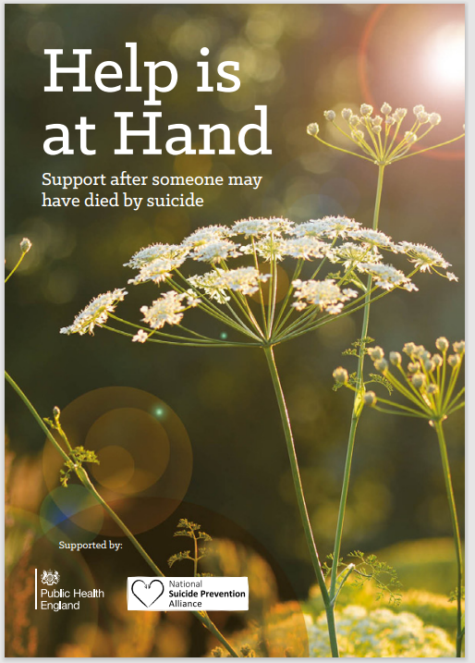

Bereavement is complex for family and friends

Slide 45
Links to OHID publications on physical health and premature mortality in adults with SMI
Severe mental illness Fingertips profile
Premature mortality in adults with severe mental illness
Premature mortality during COVID-19 in adults with severe mental illness
Severe mental illness (SMI) and physical health inequalities
British Journal of Cancer - SMI and cancer screening inequality.

Slide 46

Thank you

